Slide 1
Resilix AI
Predict. Prioritize. Reroute. Before Disaster Strikes.
An AI-powered command platform that predicts multi-hazard infrastructure failures and helps emergency teams respond faster — integrating flood risk, grid stress, voice triage, and dynamic routing into one unified intelligence layer.
PREDICT
PRIORITIZE
REROUTE
Flood risk + transformer overload before they cascade
Voice triage extracts urgency from emergency calls in <3 seconds
Dynamic A* routing avoids predicted hazard zones in real time
Team: BENADRYL
Track: Sustainable energy and resource innovation
Hackathon: WE HACK
Contact: 8767222937

Slide 2



PROBLEM UNDERSTANDING
Cities React Too Late
Severe weather creates cascading, simultaneous infrastructure failures — but emergency response systems remain fundamentally reactive, unable to see the full picture until it's too late.
The Cascade of Failure
Why Today's Response Fails
1
Underground Drainage
Risks evolve faster than assessment
Critical information buried in audio
Pipes overflow, surface water accumulates across streets and intersections
Disaster conditions change in minutes; teams update in hours
Emergency calls carry location and urgency data — but no system extracts it automatically
2
Electrical Grid
Transformers overheat, blackout risk rises across neighborhoods
3
Road Networks
Routes become hazardous mid-journey
No unified operational view
Routes become unsafe or blocked — often after responders are already en route
Responders navigate blind to infrastructure changes happening in real time
Infrastructure data, emergency calls, and routing exist in disconnected silos
Emergency teams need to know where risk is building, what calls are urgent, and which routes are still safe — before conditions become critical.

Slide 3


PROPOSED SOLUTION & RELEVANCE
One Intelligence Layer
From Reactive Response to Predictive Response — Resilix AI integrates three core capabilities into a single unified platform, giving emergency dispatchers a real-time command view of infrastructure risk, call urgency, and safe routing simultaneously.
PREDICT
UNDERSTAND
RESPOND
XGBoost models forecast drainage pressure and transformer thermal stress before failures occur. Risk scores update continuously as weather data streams in.
Whisper transcribes incoming emergency calls. SpaCy NER extracts location names, hazard categories, and urgency scores (0–100) in under 3 seconds — no human triage bottleneck.
NetworkX A* routing rebuilds the road graph in real time, recalculates edge weights for predicted hazard zones, and delivers the fastest clear route to dispatchers.
3D Urban Emergency Command Dashboard
Value Proposition
All three engines feed into a single Next.js + Mapbox GL / Deck.gl dashboard — one screen for prediction, triage, and routing decisions
Resilix AI turns scattered environmental, infrastructure, and emergency-call data into actionable decisions in real time — before conditions become critical

Slide 4

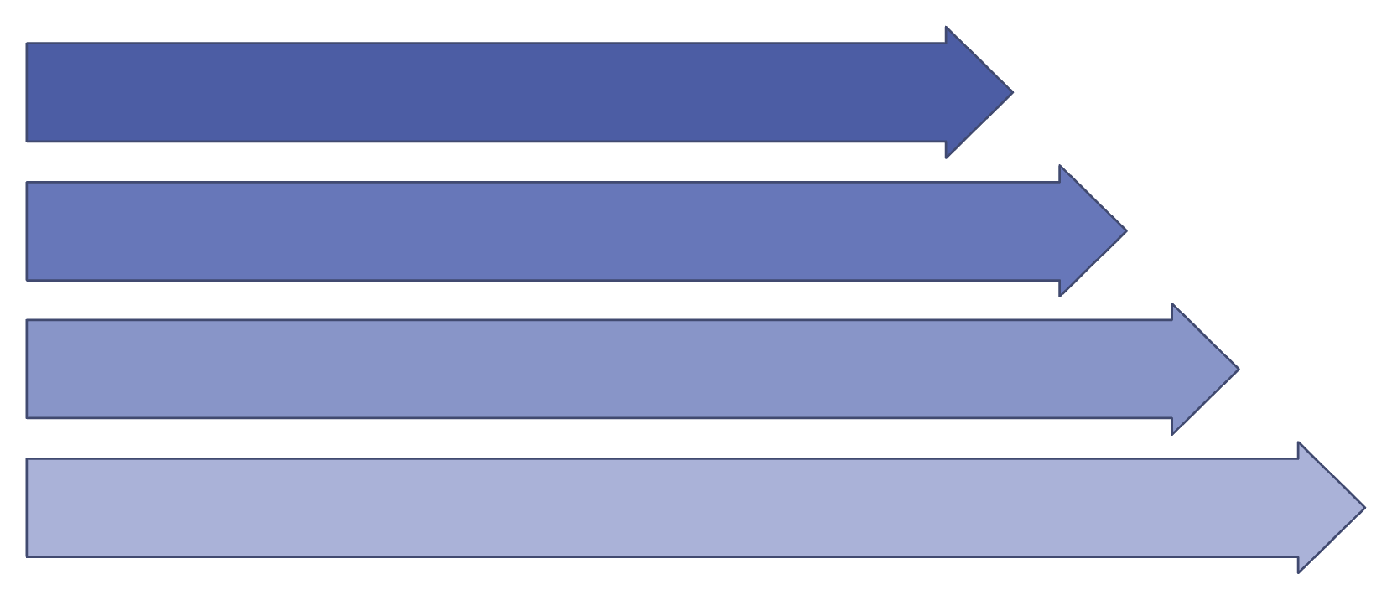


TECHNICAL APPROACH
How Resilix AI Works
End-to-end data flow from open public APIs through AI inference engines to the emergency dispatcher — a fully modular Python backend with real-time WebSocket updates at <200ms latency.
Stack Components
Data Ingestion
1
2
FastAPI Backend
Data Layer
Backend
AI Inference
Open-Meteo weather API · OpenStreetMap road graph · Synthetic infrastructure telemetry simulating sensor streams
Python FastAPI — REST + WebSocket APIs · <200ms real-time update latency · Modular service architecture
Routing & Dashboard
3
4
AI Engines
Frontend
XGBoost regression · Whisper transcription · SpaCy NER extraction · NetworkX A* graph routing
Next.js + Mapbox GL + Deck.gl — 3D terrain, risk heatmaps, vehicle routing, triage panel

Slide 5

AI ENGINES
Three AI Engines. One Emergency Decision.
Each engine targets a distinct gap in urban disaster response. Together they form a closed loop: predicted risk informs triage priority, triage data updates routing, and routing avoids the hazard zones prediction already identified.
Predictive Risk Engine
Voice Triage Engine
Dynamic Routing Engine
XGBoost Regression
Whisper + SpaCy NER
NetworkX + A*
Forecast drainage pipe pressure under storm load
Predict surface water accumulation zones
Evaluate transformer thermal stress index
Calculate blackout probability per grid sector
Audio → text transcription via Whisper
Extract street and district location names
Classify hazard category from call content
Generate urgency score 0–100 in <3 seconds
Build live road graph from OpenStreetMap
Flag affected nodes based on risk scores
Recalculate edge weights for hazard zones
Find fastest clear route dynamically
Example end-to-end: Emergency call received → "Central Bridge" extracted → Hazard classified as MEDICAL → Urgency score 94/100 → GPS coordinates resolved → Flood-risk overlay applied → Safe alternate route generated in <3 seconds → Dispatcher receives actionable dispatch instruction

Slide 6



INNOVATION & ORIGINALITY
Why Resilix AI?
The core innovation is not any single AI model — it is the closed-loop integration of prediction, triage, and routing. Each engine feeds the next, creating a compounding intelligence advantage no siloed tool can replicate.
The Integrated Loop
Key Differentiators
Multi-hazard intelligence
Unified view of water, power, and road risk simultaneously — not siloed alerts
Predictive, not reactive
Anticipate cascading failures before they compound — act before the window closes
Ingest
Predict
Receive
Extract
Update
Voice-to-action triage
Extract urgency and location from emergency calls in <3 seconds — no bottleneck
Hazard-aware routing
Dynamic A* avoids predicted danger zones — not just currently reported ones
Zero hardware required
Pure software platform using synthetic telemetry and public APIs — deploy anywhere
Integrated AI stack
ML + NLP + GIS + graph algorithms in one closed loop — not four separate tools

Slide 7


FEASIBILITY & DEMO
Built to Be Demonstrated
Resilix AI is designed for a 36-hour hackathon delivery window. Every component uses battle-tested open-source libraries and public APIs — no proprietary infrastructure, no hardware dependencies, no black-box models.
3D Command Dashboard Features
Live Demo Scenario
City map with 3D terrain
Flood-risk heatmap (0–100 scale)
01
Mapbox GL + Deck.gl rendering of full urban topology
Color-coded overlay driven by live XGBoost risk scores
Storm intensity increases
Open-Meteo feeds updated precipitation data to backend
02
Transformer status indicators
Vehicle routes + hazard zones
Drainage risk score rises
● Normal | ● Warning | ● Overload per grid sector
Live A* paths overlaid on predicted risk areas
XGBoost flags high flood-risk zones on the 3D map
03
Emergency call triage panel
Transformer warning triggered
Real-time urgency score, location, and hazard classification per call
Grid thermal stress model elevates sector to Warning status
04
Emergency call received
Whisper transcribes audio; SpaCy extracts location + urgency score 94
05
Hazardous road identified
Affected graph nodes flagged; edge weights recalculated
06
A* alternate route generated
Dispatcher receives safe route — total response time <3 seconds
Performance targets met: WebSocket updates <200ms · Audio triage <3 seconds · Pure software — no sensors or cameras required

Slide 8
See the Risk. Understand the Emergency. Move the Response.
Resilix AI turns real-time urban risk into real-time emergency action — a unified intelligence layer that gives dispatch teams the predictive clarity to act before disaster cascades.
<3s
<200ms
Voice Triage
WebSocket Updates
Audio → urgency score + location extracted from emergency calls
Real-time infrastructure risk data streaming to the command dashboard
3
0
AI Engines
Hardware Required
XGBoost · Whisper + SpaCy · NetworkX A* — one closed loop
Pure software platform — synthetic telemetry + public APIs only
PREDICT
PRIORITIZE
Flood + grid failure before cascade
Urgency from voice in <3 seconds
REROUTE
RESPOND
Dynamic A* avoids hazard zones
Dispatcher acts with full situational clarity
Team: BENADRYL · Members: Ashmit Sharma, Shaurya Singla, Abhimanyu Naveen, Anannya Rodge

